Slide 1
SPORT
ANALYSIS-PSL
GROUP MEMBERS:
NEETA CHOUDHRY
NAVEERA KAMAL
NOOR UL AIN

Slide 2
TABLE OF CONTENTS
Introduction
Problem Statement
Objectives
Data Overview
Exploratory Data Analysis
Key Findings
Recommendation

Slide 3
INTRODUCTION
Pakistanis deeply passionate about cricket, integral to culture.
Pakistan Super League (PSL) pivotal, gains massive attention.
"SPORTS Analysis - PSL 2016-2022 Data Analysis" project: Comprehensive PSL data analysis 2016-2022.

Slide 4
PROBLEM STATEMENT
The "SPORTS Analysis - PSL" initiative is focused on addressing the challenges in extracting insights from vast PSL dataset
The need for effective approach to derive valuable information.
Enhancing data utilization for improved decision-making in PSL.

Slide 5
OBJECTIVES
Teams Performance Analysis
Top runs scorer of the Season
Impact of Players Age on their Performance
Top Players with 100s and 50s
Top Bowler and Batsman Averages
Performance of All Rounder Players
Top players with most Catches
Top players with most Stumps
Number of 50s scored by teams
Players Age Distribution

Slide 6
DATA OVERVIEW
We obtained the dataset from Kaggle, which includes: https://www.kaggle.com/datasets/ibadkhanml/psl-matches-2016-to-2022?select=matches.csv
The PSL dataset encapsulates a comprehensive record of the Pakistan Super League cricket tournament, spanning from 2016 to 2022.
It consists of multiple teams representing different cities in Pakistan.
Notable venues include Dubai, Sharjah, Lahore, Rawalpindi and Karachi.
PSL has witnessed international and local player participation.

Slide 7
KEY ATTRIBUTES
Match Details:
Match date and time.
Venue and location of the match.
Match outcome (win/loss/tie/abandoned).
Match result summary (scores, wickets, overs, and run rates).
Team Information:
Names of the participating teams.
Team abbreviations or codes.

Slide 8
KEY ATTRIBUTES Cont..
Player Details:
Names of players participating in each match.
Player roles (batsman, bowler, all-rounder, etc.).
Player Performance:
Batting statistics (runs scored, balls faced, boundaries, etc.).
Bowling statistics (overs bowled, wickets taken, economy rate, etc.).
Fielding contributions (catches, run-outs).
Player Ratings:
Player ratings that reflect performance and impact.

Slide 9
EXPLORATORY DATA ANALYSIS
EDA is an approach in data analysis.
It involves systematic examination, summarization, visualization, and interpretation of data sets.
The goal is to extract meaningful insights, patterns, and relationships from the data.
EDA helps analysts explore data from different angles and perspectives.

Slide 10
KEY FINDINGS
Correlating Team Performance, Points, NRR, and Ranks Across Seasons

Slide 11

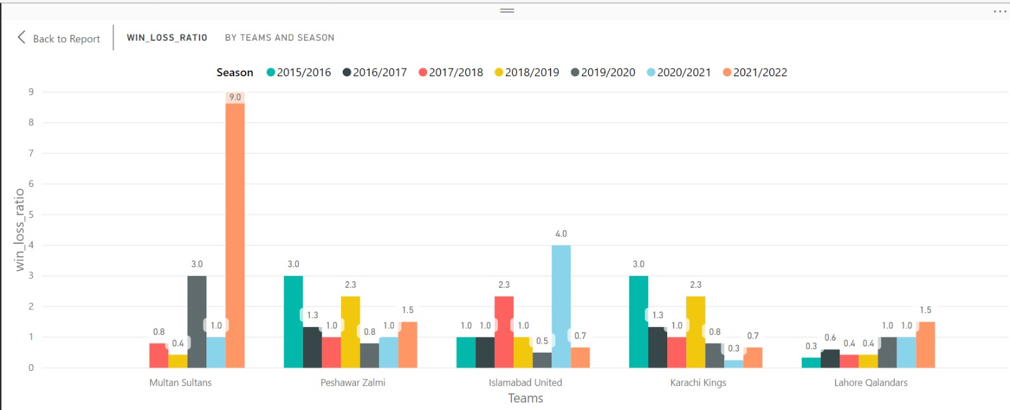
Team Win-Loss Ratios by Season
In the period of 2021/2022, Multan Sultans achieved an impressive win percentage of 90%, marking the highest rate of victories among all teams.

Slide 12
Top Run Scorers In Each Season
Fakhar Zaman, representing Lahore Qalandars, stands as the foremost top scorer in the Pakistan Super League (PSL), boasting an impressive tally of 588 runs.

Slide 13
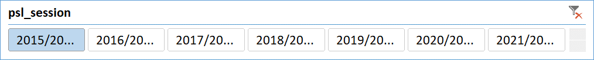
Impact of Player Age on Performance in Each Season

Slide 14
Top Bowling Averages in PSL:
Top Batsmen Averages in PSL:
Jofra Archer holds the distinction of having the highest bowling average of 2.5 in the Pakistan Super League.
Baber Azam holds the distinction of having the highest batting average of 344.7143 in the Pakistan Super League.

Slide 15
Prominent All-Rounders and Their Impact on Batting and Bowling Performances:
Analyzing the all-rounder players in the PSL offers valuable insights into their multifaceted contributions to the league.
Shane Watson stands out as the leading all-rounder in the Pakistan Super League, boasting both the highest run total and the most wickets among players who excel in both batting and bowling roles

Slide 16
Top Fielders : Most Catches and Stumpings by Players
Kamran Akmal stands out for holding the distinction of having the most catches across all seasons in the Pakistan Super League.
Muhammad Rizwan stands out for holding the distinction of having the most stumps across all seasons in the Pakistan Super League.

Slide 17
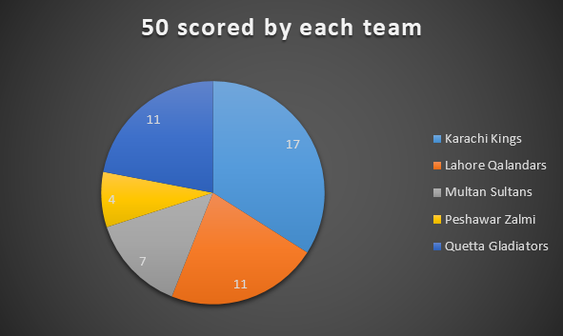
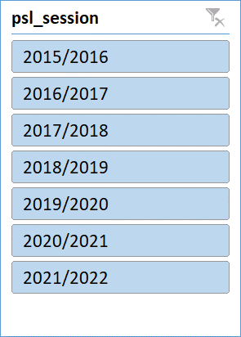
Team-Wise Analysis: Total Number of Half-Centuries (50s) Scored Across All Seasons
Karachi Kings has achieved the highest number of 50s scored, while Peshawar Zalmi has the lowest count of 50s scored among the teams.

Slide 18
Most Centuries and Half-Centuries Across All Seasons
Fakhar Zaman has achieved the milestone of scoring 7 half-centuries (50s) and 1 century (100) in the Pakistan Super League.

Slide 19
Age Distribution of Players A Comprehensive Overview
The age group distribution reveals a balanced mix of players across various stages, with a majority aged 19 to 35, signifying the core impactful players

Slide 20
RECOMMENDATION
The dataset reveals a batsman's struggle against certain bowling styles through their strike rate, allowing us to propose focused practice against those bowlers for improvement.
After evaluating the bowler's performance data, it's evident that suboptimal outcomes exist. To address this, we suggest focusing on targeted enhancements in physical conditioning and strength training to unleash their full potential.
Strategically assemble player combinations that balance batting and bowling strengths while ensuring a suitable allocation of all-rounders. This approach enables the team to effectively adapt to match conditions and drive favorable outcomes.

Slide 21

THANKS!
Do you have any questions?

